Slide 1
JS and DOM Manipulation

Slide 2
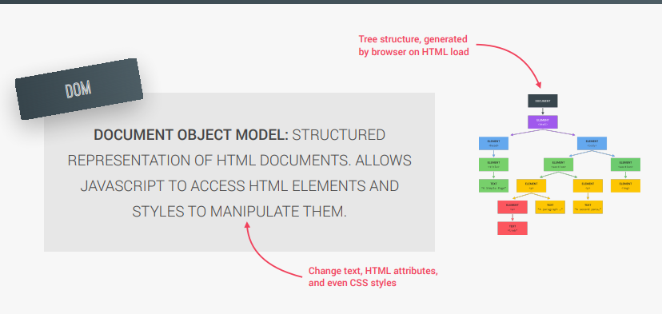
DOM
We know what is JS, but what is DOM?

Slide 3
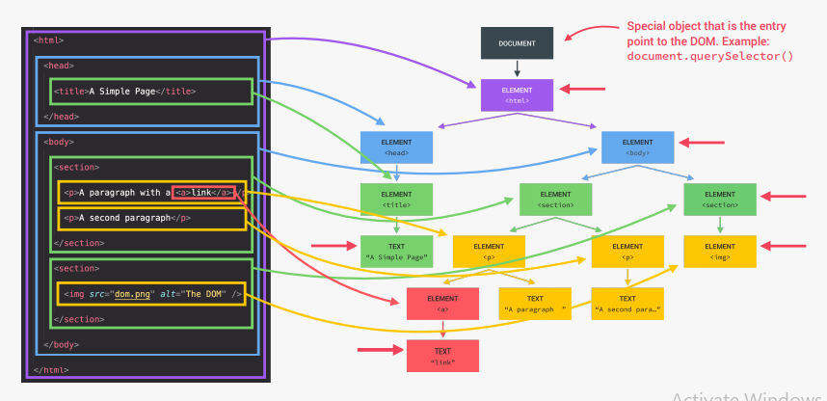
DOM Tree structure

Slide 4
Short reminder
CSS is just the file which defines details about our webpage (color of elements, sizes, font, style…)
Some elements can have Id or class.
When element has Id or class it is much easier to access it, use it or change it (without changing other elements).
In css element of Id “someId” → #someId
In css element of class “someClass” → .someClass

Slide 5
First steps
In order to make some changes to DOM, we first need to have some html file to make changes to it
So let’s try to select one DOM element
We will select element with class .message
Command to do that:
On current document do the action of querySelector for element with class name = ‘message’.
We can select element by Id too.

Slide 6
How do we know we selected the element?
In developerTools – we can write command from previous slide directly in Console
Or we can write it inside console.log() in the javascript file. Then we can see changes in Console when we reload the page
To see the text inside the element:

Slide 7
Reading vs Setting value
If we can read the value like in the previous slide, can we set it?
Of course we can
To set the value we need to access the element and then store different value inside of it:
Now let’s see the change on our webpage

Slide 8
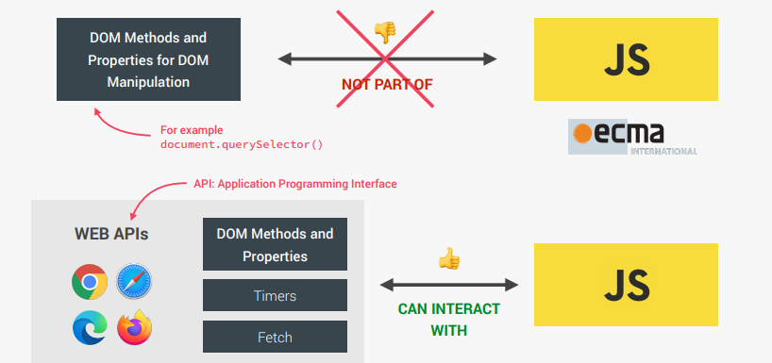
DOM != JS
Remember – DOM can be used and modified by JS, but != JS
Dom methods such as the one we used, are available for us to use

Slide 9
Let’s get back to the code
Now let’s change the values of elements of class:
Message → (new value) = Correct number!
Number → (new value) = 13
Score → (new value) = 20

Slide 10

How to change input value
We have one element with input value. Class of that element is “.Guess”
So we can set value to it, and we can show it to console:

Slide 11
What to do with the button?
First thing to mention – we want the webpage to listen to an event
Event can be – mouse click, pressing the key (on keyboard), mouse moving, hovering element…
Idea is to make webpage do something when we click the button
So first we need to select that button element
See that button Check has two classes… which to choose?
Let’s try both and see which is better.

Slide 12
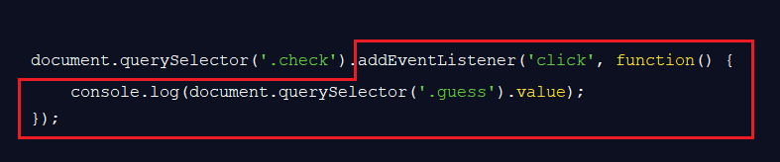
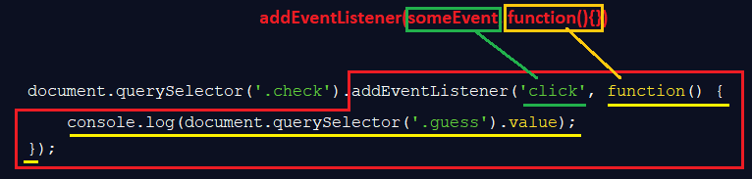
Adding event listener

Slide 13
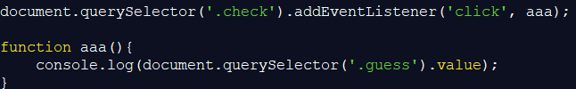
A bit easier approach
Still the same code just function is defined outside of the event listener:
First we select element (of .check class)
We add event listener to it
We make listener listen to ‘click’ event
When ‘click’ event happens, then execute the function

Slide 14
Let’s make it more complicated
Let’s make button when clicked not just show number to console
Now when clicked:
Show “Correct number” text in the message class element
Then see what to do when there is no guess number:
See why !guess works? (Hint: bool values in JS)

Slide 15

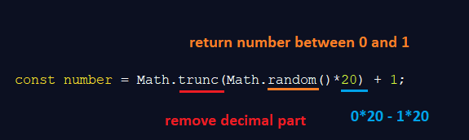
Random Number
Let’s add secret random number each time we start the game:
Since we want number between 1 and 20 , we need to make some changes

Slide 16
Game logic
When we start game – (for now) show number in upper middle box
Let’s rename number to secretNumber
When we guessed the number show message in message element: Correct number
When we miss, show message Too Low or Too Big to help out the player
Each time you miss the score goes down for one point…
If score is 0 then display – You lost message

Slide 17
Only two things missing
Again (guess what will come as a challenge ☺ )
Highscore
Plus we need to make some changes to our CSS, to show that we actually won or lost.

Slide 18
Colors
Green color when Guessed!
Set to Red when lost!
Let’s set secretNumber to show only if we win
Now box with number should show ? instead of correct number (until we win)

Slide 19
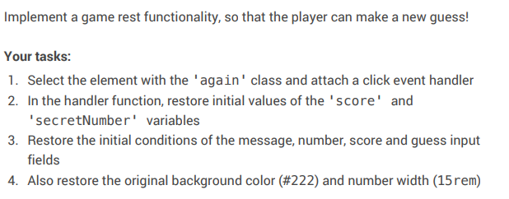
Coding challenge

Slide 20

Homework
Make a webpage that will represent: throwing dice
Only one dice will be thrown
Start with the html file
Webpage shoud have number Box for number on the dice
Button for throwing new dice
When you start webpage – there will be no number in the box
Each time you throw the dice, new number will show

Slide 21
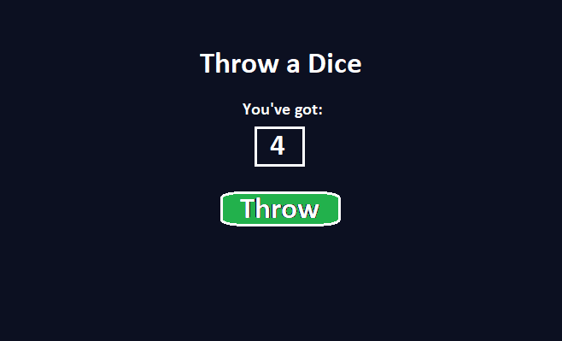
How it should look like

Slide 22
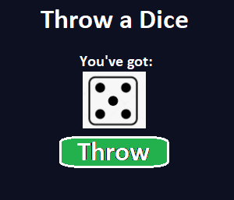
Bonus part of the homework
You can download 6 pictures of dice with numbers 1, 2, 3, 4, 5, 6
Copy those files to folder where you have your index.html and script.js file.
Then make the javascript show image instead of number
It should insert location of the image file in the image element in DOM

